Slide 1



The Data Detective’s Toolkit: An EDA Walkthrough Strategies, Techniques, and Real-World Applications
Under the Guidance of: Dr. Stephen Wheeler, Ph.D. (AI/ML)
Presented by:
Krishna Annavaram

Slide 2
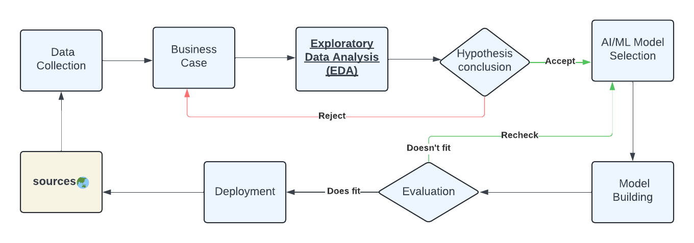
EDA in the Data Science Workflow

Slide 3
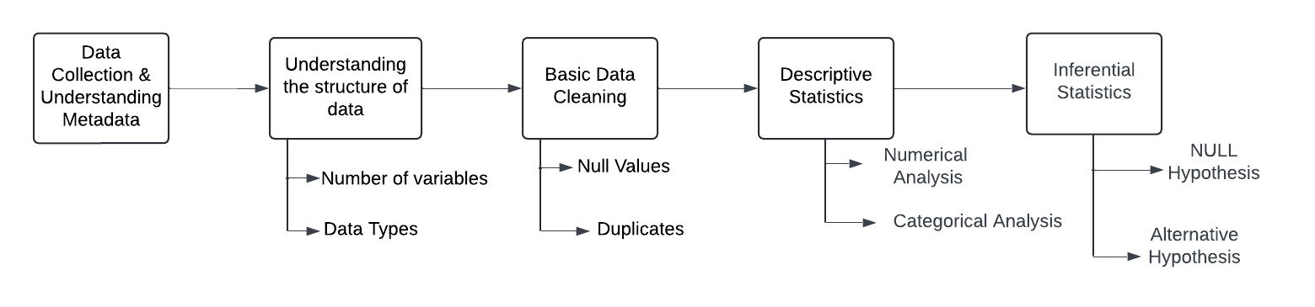
EDA Workflow

Slide 4
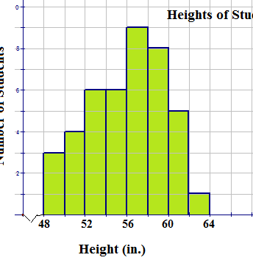
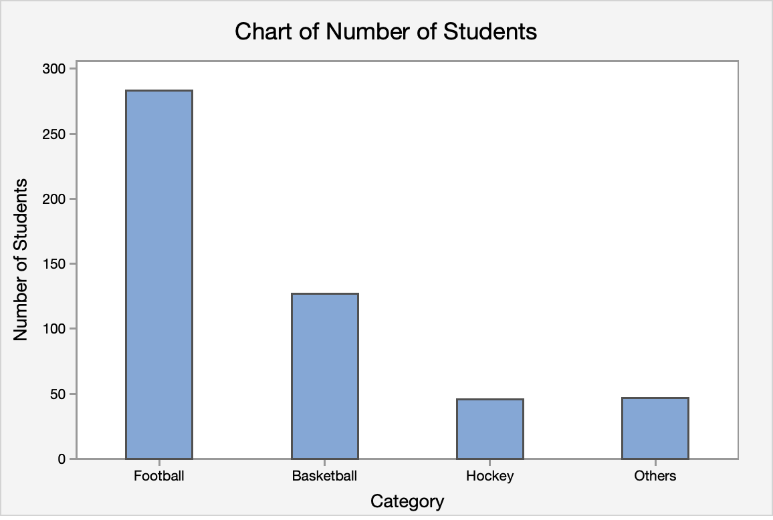
Data Collection & Metadata Analysis
What is Meta Data:
Metadata is "information about main data”
Check whether the data refers Population/Sample
Types of data collected (Research/Observational)
Data Source
Sampling techniques used (Random/Probability)
Understanding Structure of Data
Number of Variables (Rows and Columns)
Data Types of Variables 1) Numerical Data (Discrete Data/Continuous Data) Quantitative data that can be measured. 2) Categorical Data (Nominal/Ordinal) Qualitative data that can be categorized into groups. 3) Date/Time

Slide 5
Basic Data Cleaning
Null Values: Null values represent missing or undefined data in a dataset.
If null values < 5% => drop null values (Not Mandatory)
>=5% => Find mean, median, mode (categorical)
Duplicates: Repeated entries in the dataset that often occur during data collection or merging processes. We can drop the duplicates.’
Spell Mistakes: Errors in textual data due to typos, inconsistent capitalization, or incorrect grammar. Spelling mistakes can lead to categorization errors and inconsistency in data (e.g., locations)
Data Type Correction: This involves ensuring that all data entries in a column are stored with the correct data type (e.g., numbers stored as integers or floats, dates in date/time format).

Slide 6
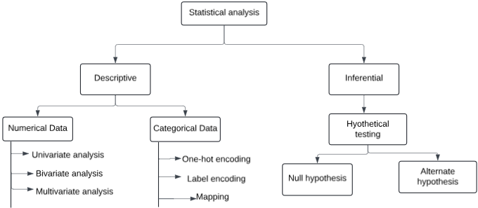
Statistical Analysis:
Univariate analysis: Central Tendency (Mean, Median, Mode) and Variability (Standard deviation, Variance), Outliers.
Graphs used: Histogram, Box Plot, Density Plot etc.,
Bivariate analysis: Graphs used: Scatter Plot, Pair Plot, Correlation Matrix
Multivariate analysis: Graphs used: Heatmap

Slide 7
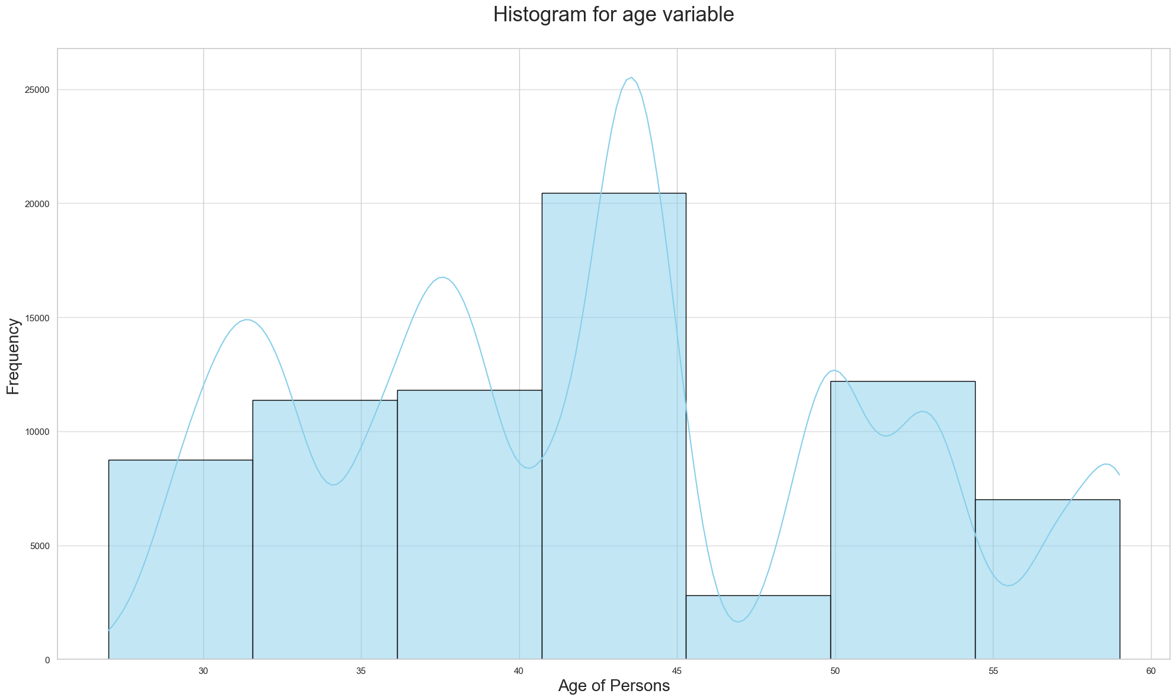
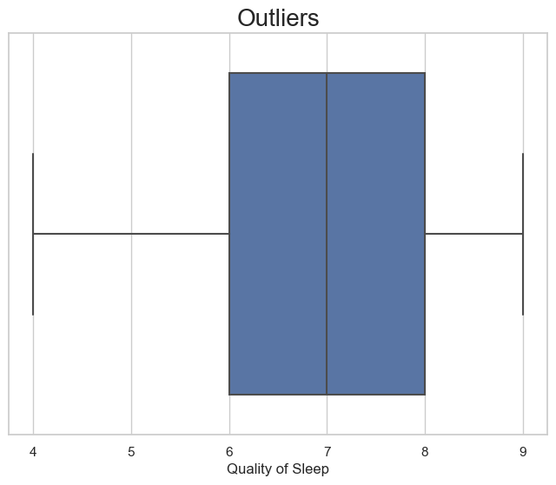
Univariate analysis:
.
Histogram: Splitting up the data by range into equidistant bins and plotting the raw count of observations in each bin.
Skewness – Direction of the Tail: Measures the asymmetry of the data distribution. Right-skewed has a longer right tail; left-skewed has a longer left tail.
Kurtosis – Sharpness of the Peak Describes how peaked or flat a distribution is. High kurtosis means heavy tails (more outliers); low kurtosis means flatter shape.
Box Plot: We use five no. summary here – Min (0%), Q1 (constituting to 25%), Median (50%), Q2 (value is 75%), Max (value is 100%)
Inter Quartile Range is Q3 – Q1
Lower Fence = Quartile1 – 1.5(IQR)
Higher Fence = Quartile3 + 1.5(IQR)
Density plot: By smoothing the histogram, density plots calculate the probability density function of a continuous variable.
Univariate analysis helps detect patterns, outliers, and anomalies in individual features essential before modeling or transformations.

Slide 8
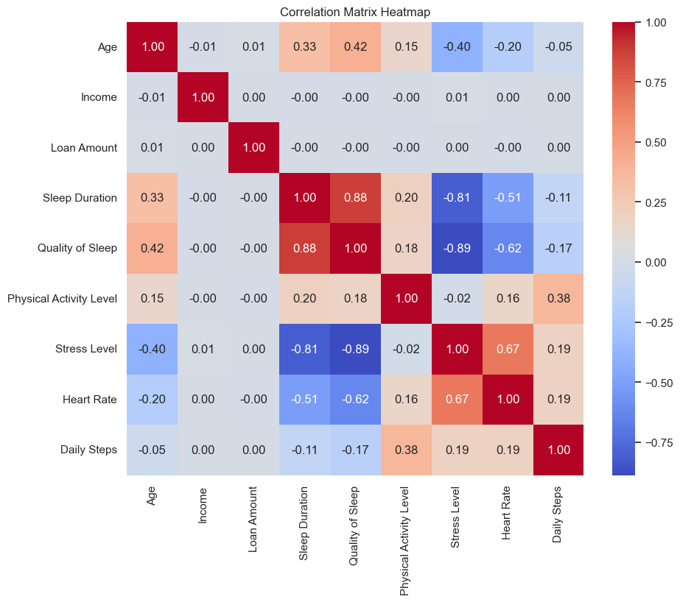
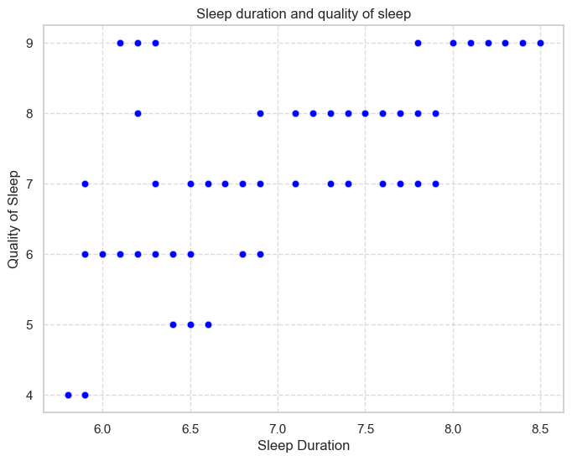
Bivariate Analysis & Multivariate Analysis
Scatter plot: It’s a graphical representation of bivariate data in which the x and y-axes are used to plot various variables and each of the data point is represented by a dot on the plot.
Pair plot: Pairwise bivariate graphical representation
Explores the relationship between two variables, typically to identify trends, associations, or potential causation.
Multivariate Analysis: Exploring Complex Interactions
Heatmaps: An illustration of the connections between variables in a dataset is called a heatmap.
It shows a color matrix with each cell representing the point where two variables intersect with a correlation
Positive correlation
Negative correlation
No correlation
Analyzes the relationship among three or more variables to detect interactions, higher-order trends, and feature importance.

Slide 9
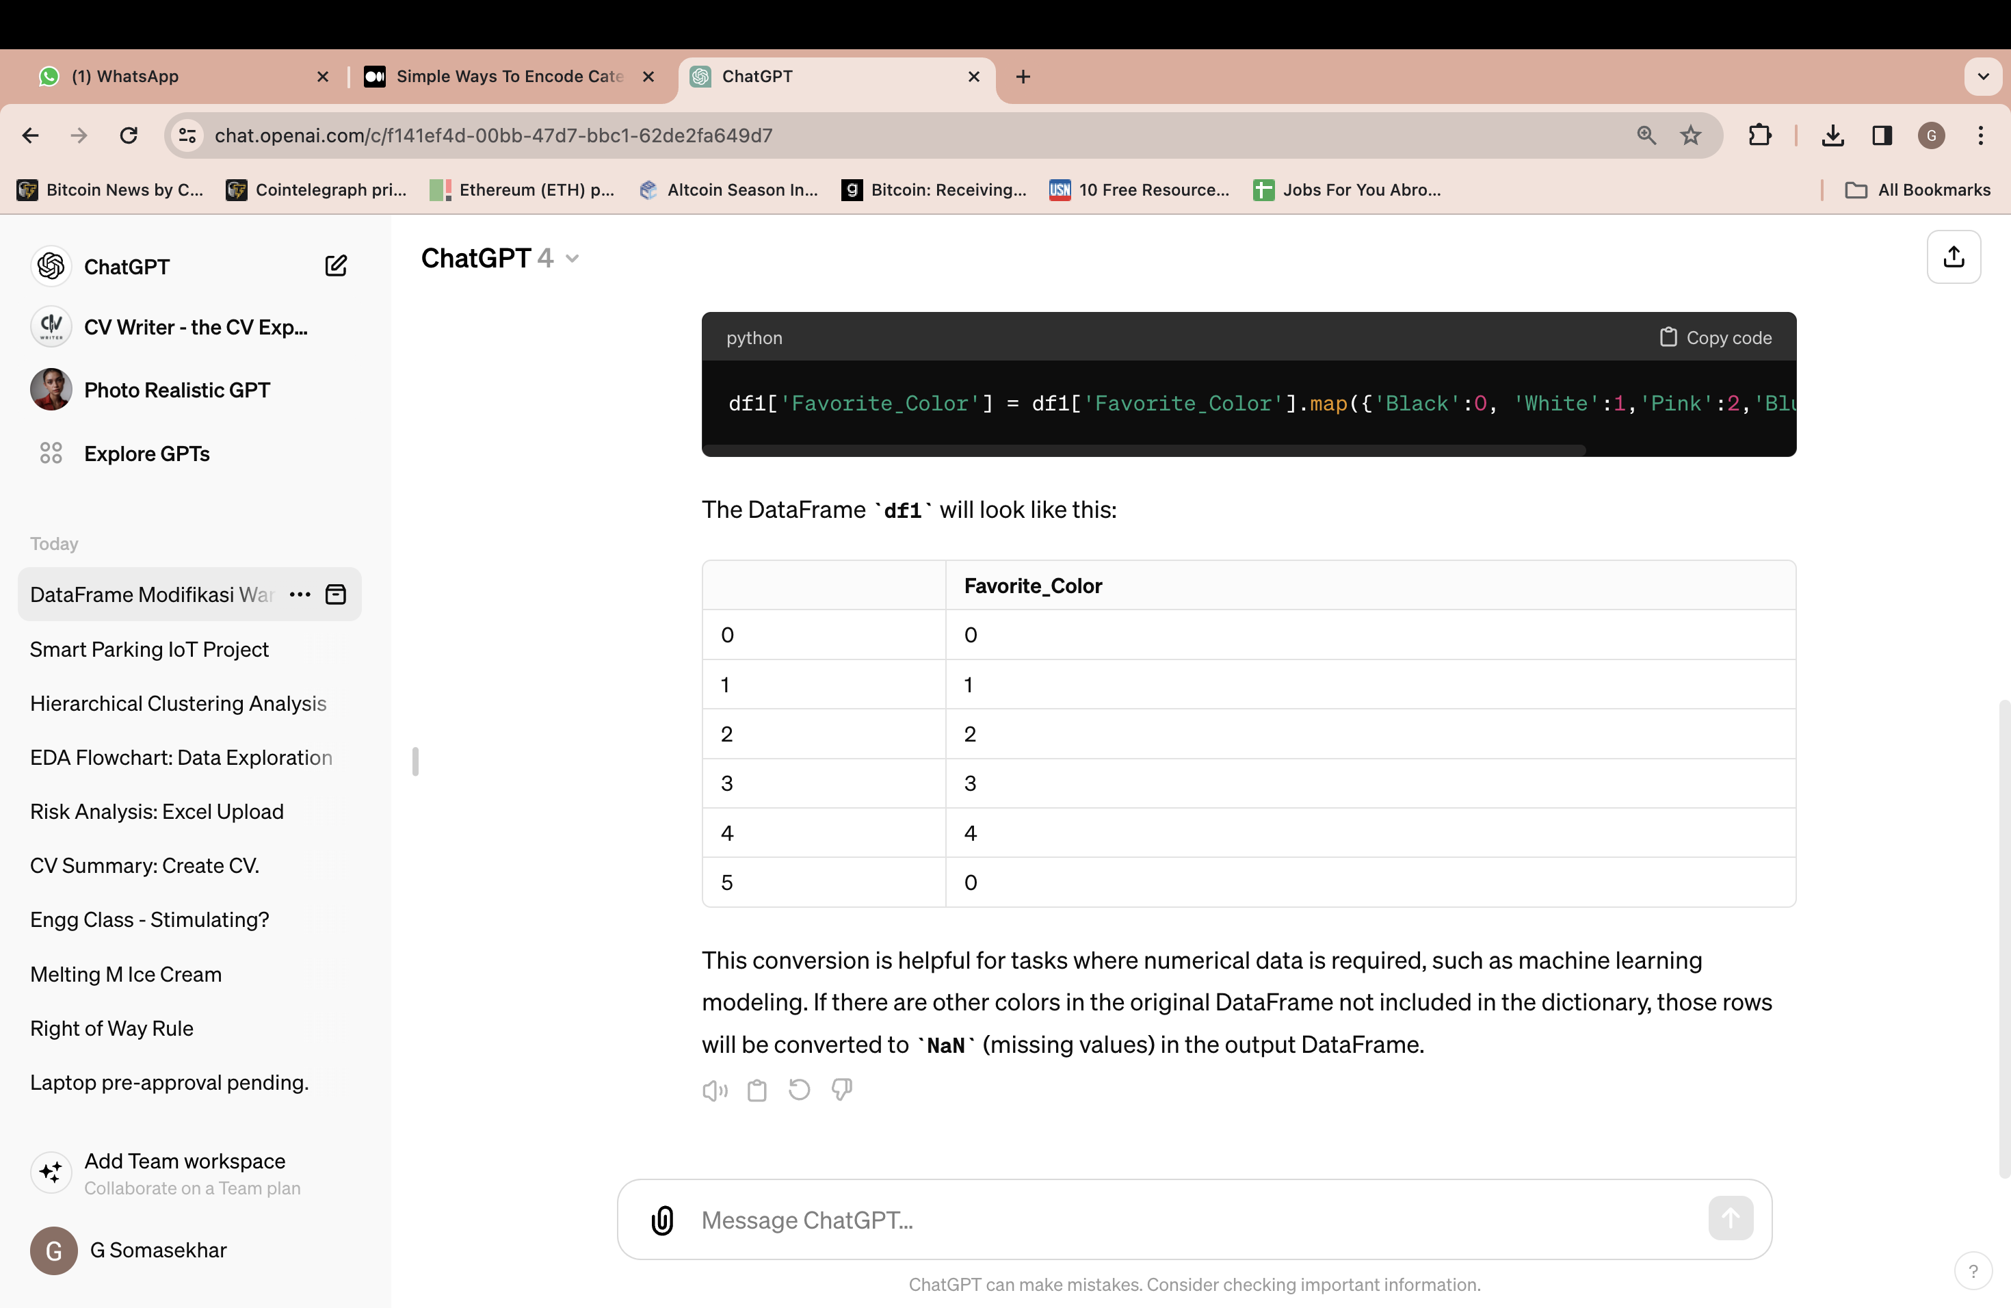
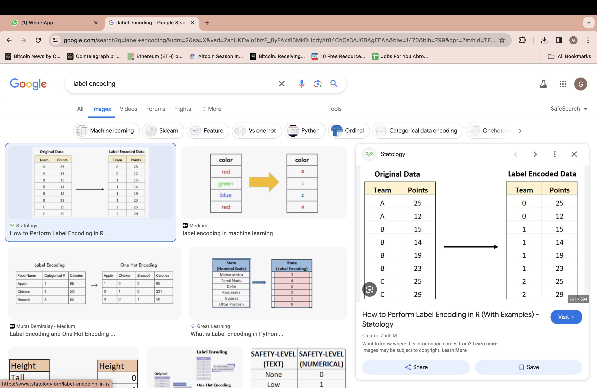
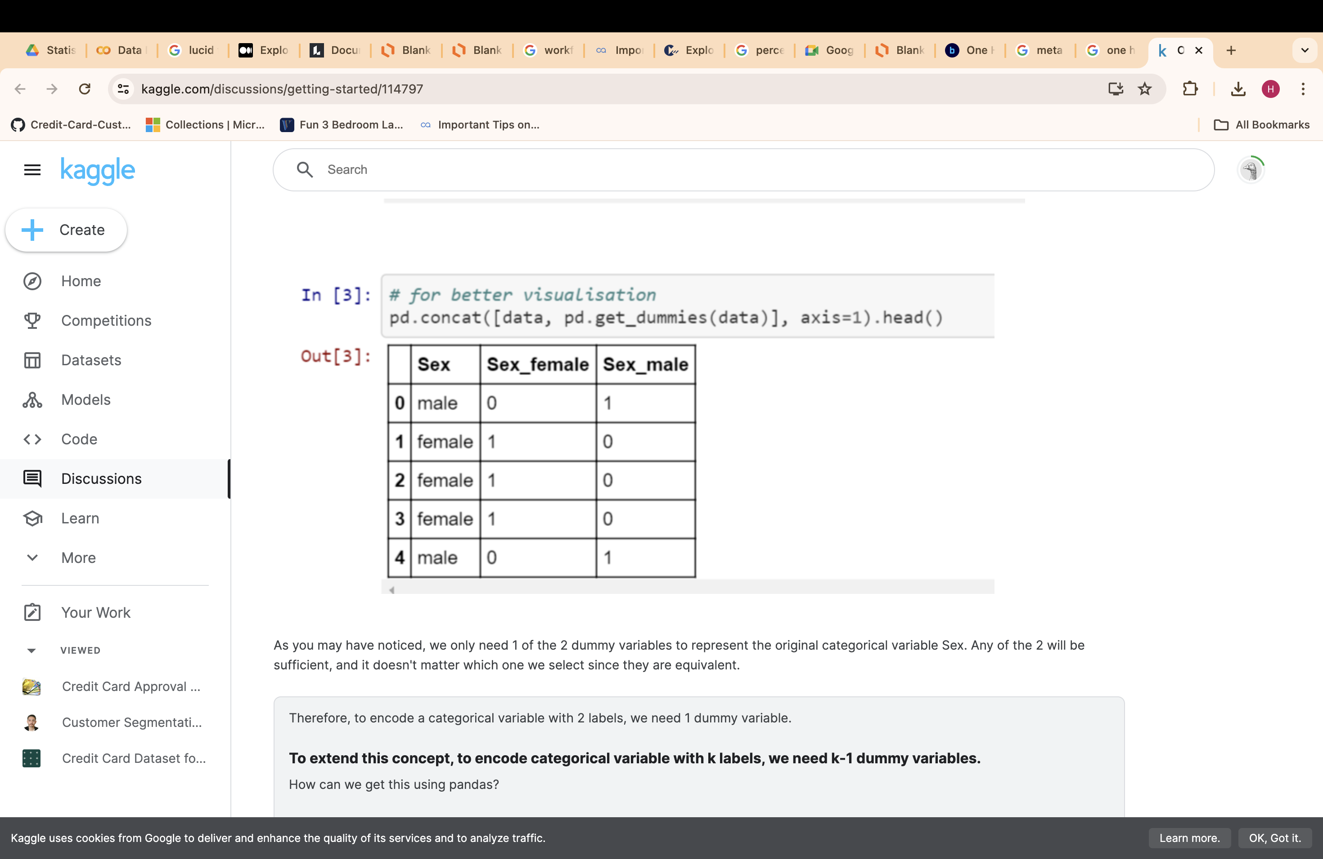
Convert Categorical Data to Numerical Data
Mapping : This is similar to Replace function. Here we map categorical values to numeric values as per the priority.
Label Encoding: Here we assign each categorical value to an integer value based on the alphabetical order.
One-Hot Encoding: Here new variables are created which take on values 0 and 1 representing the original categorical values.
No. of newly created variables = no. of unique categories in the feature – 1.
Machine learning algorithms require numerical input. Encoding transforms categorical (text-based) features into a form the models can understand.
df1['Favorite_Color'] = df1['Favorite_Color'].map({'Black':0, 'White':1,'Pink':2,'Blue':3, 'Yellow':4})

Slide 10
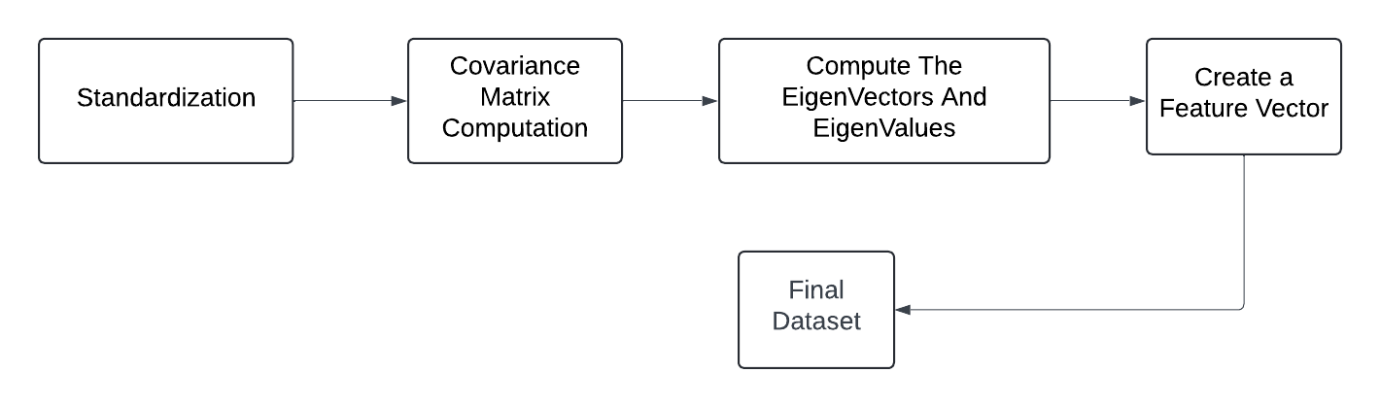

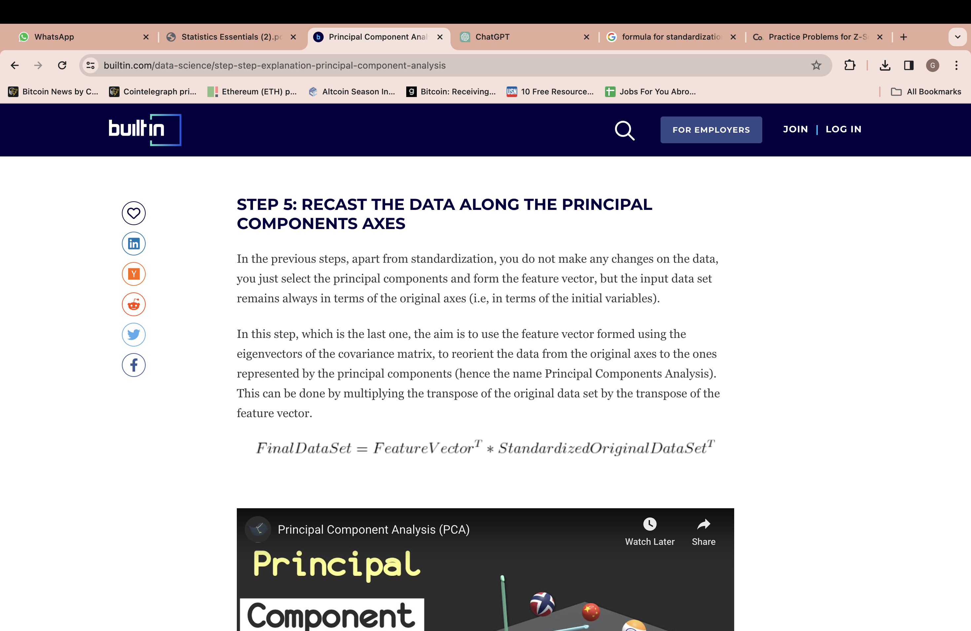
Dimensionality Reduction: Simplifying High-Dimensional Data
The process of reducing the number of input variables (features) in a dataset, while retaining as much informative variance as possible.
Principal component analysis (PCA) is a linear dimensionality reduction technique primarily used with EDA, Data visualization and Data preprocessing.
Step-by-Step Explanation of PCA:

Slide 11
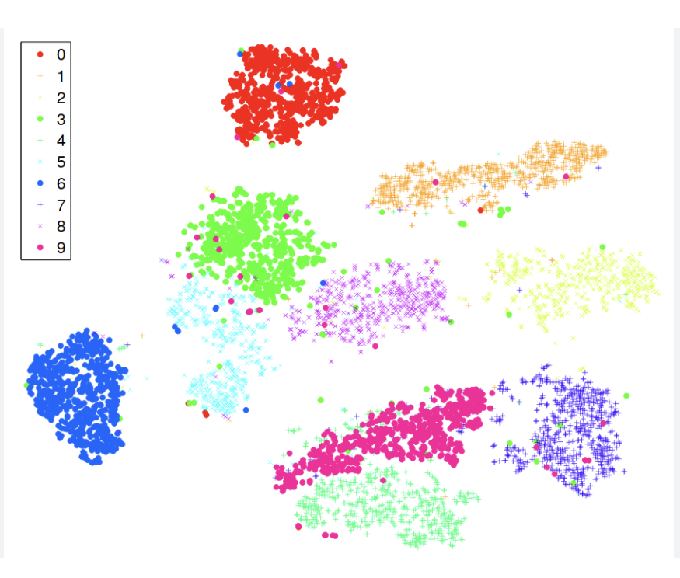
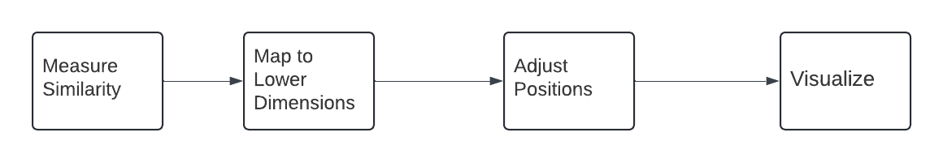
Dimensionality Reduction Techniques
t-SNE is a non-linear dimensionality reduction technique used with exploration of data and also helps in the visualization of the high-dimensional data.
Non-linear dimensionality reduction helps us in the separation of the data which cannot be usually done by a straight line.

Slide 12
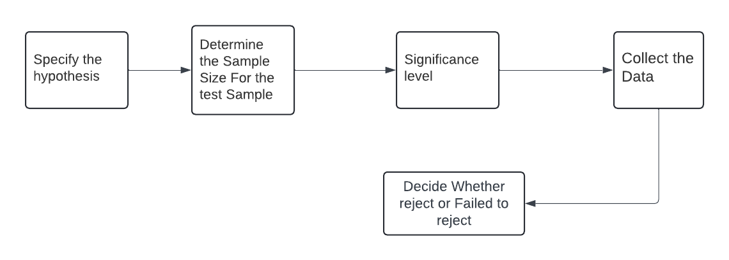
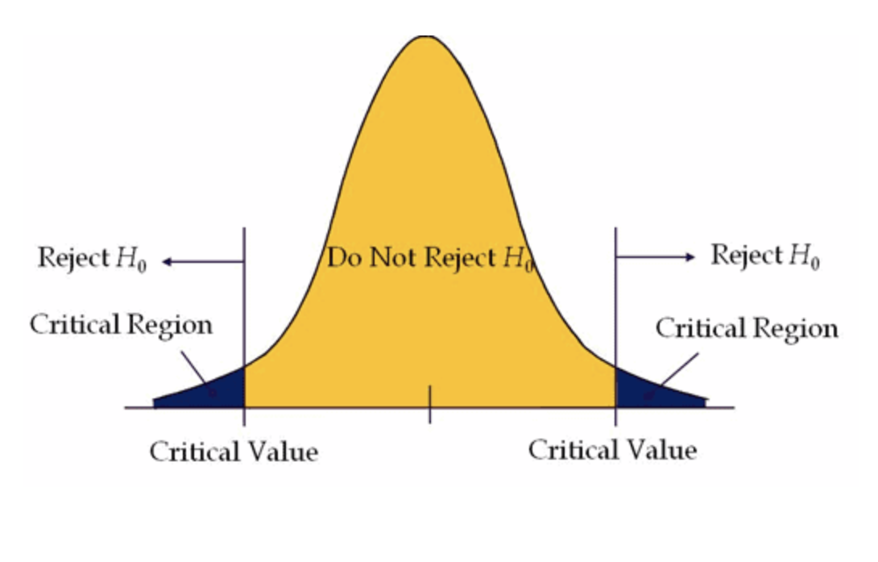
Inferential Statistics: Making Decisions from Data
It allows us to make probability-based conclusions about a population based on a sample. Core to testing assumptions and validating insights.
Conducting a hypothesis test
Null hypothesis (H₀) : Assumes there is no effect, no difference, or no relationship between variables.
Alternate hypothesis (H₁ or Ha) : Assumes there is an effect, a difference, or a relationship between variables.

Slide 13
Types of Hypotheses in Statistical Testing
Parametric Tests: Used when data follows a normal distribution and meets specific assumptions (e.g., equal variance).
Non-Parametric Tests: Used when data does not meet parametric assumptions suitable for ordinal data or non-normal distributions.
Test | Purpose
Z-Test | Compare sample mean to population mean (with known variance)
T-Test | Compare means when variance is unknown
One-sample T-test | Compare one sample mean to a known value
Two-sample T-test | Compare means of two independent groups
Paired T-test | Compare means from the same group before & after
ANOVA (One-Way) | Compare means of 3 or more groups
Test | Purpose
Chi-Square Test | Tests for association between categorical variables
Mann-Whitney U Test | Compare medians of two independent groups
Wilcoxon Signed-Rank Test | Compare paired samples (non-parametric alternative to paired T-test)
Kruskal-Wallis Test | Non-parametric version of ANOVA for 3+ groups

Slide 14
Real-World Applications of Exploratory Data Analysis (EDA)
🌐 Industry | 💡 EDA Use Case
Healthcare | Analyzing patient records to identify early signs of chronic conditions like diabetes, hypertension, or sleep apnea.
Retail & E-Commerce | Product recommendation systems based on user behavior, seasonal trend analysis, and inventory forecasting.
Finance & Banking | Fraud detection using outlier detection, customer segmentation for credit scoring, and market movement analysis.
Marketing & AdTech | Customer profiling, A/B test evaluation, campaign optimization, and churn analysis.
Exploratory Data Analysis is a critical first step in any data-driven workflow. It helps stakeholders understand patterns, detect anomalies, and shape business decisions based on the underlying structure of the data.

Slide 15
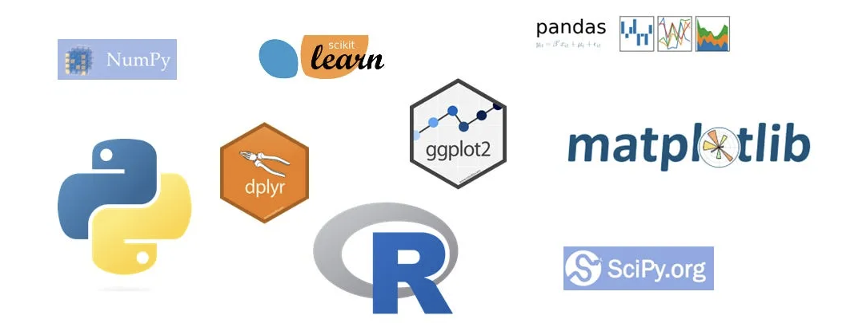
Essential Tools & Libraries for EDA
Python-Based Tools
Pandas & NumPy – Data wrangling, summaries, statistical computations
Matplotlib & Seaborn – Static and statistical visualizations (histograms, box plots, heatmaps)
Plotly / Altair – Interactive, web-based charts and dashboards
Sweetviz / pandas-profiling – Auto-generates comprehensive EDA reports
GUI & No-Code Platforms
Tableau / Power BI – Visual data exploration and dashboarding
RapidMiner / Orange – Drag-and-drop EDA and machine learning workflows
Excel + Power Query – Quick summaries and visual trends for business users
R-Based Tools
ggplot2 & dplyr – Advanced statistical graphics and data manipulation in R
tidyr – Data cleaning and reshaping

Slide 16
EDA as a Strategic Foundation in Data Science
In industry, EDA is more than an academic formality — it is the strategic foundation for all data-driven decision-making. It enables data scientists and analysts to transform raw, messy, and high-dimensional data into structured insight and business intelligence.
Key Takeaways:
EDA uncovers data quality issues early — preventing errors downstream in the modeling lifecycle.
It enables informed feature selection, hypothesis generation, and model readiness assessment.
Strong EDA practices result in better model performance, improved stakeholder trust, and faster iteration cycles.
It supports narrative storytelling with data, crucial for aligning technical findings with business goals.
In the real world, great data science doesn't start with algorithms it starts with curiosity, questions, and a deep dive into the data

Slide 17

The Future of Exploratory Data Analysis
1. Automated EDA (AutoEDA)
Tools like Sweetviz, Pandas Profiling, and Dataprep are accelerating the EDA process by generating full-scale statistical summaries and visualizations with minimal manual input helping teams scale faster and reduce time-to-insight.
2. Integration with AutoML & ML Pipelines
EDA is increasingly being integrated into end-to-end AutoML platforms, ensuring that data cleaning, feature insights, and distribution checks become part of automated workflows (e.g., Vertex AI, H2O.ai, Azure ML).
3. Multimodal & Real-Time EDA
With growth in unstructured data (text, images, audio), EDA is evolving to support multimodal exploration combining numerical, visual, and language-based insights for deeper pattern discovery.
4. Interactive & Collaborative EDA Dashboards
EDA is becoming more business-facing with tools like Tableau, Power BI, and Streamlit enabling real-time, interactive EDA dashboards that support cross-functional collaboration.
5. Responsible & Explainable EDA
With rising concerns around bias and fairness, modern EDA will increasingly focus on:
Bias detection in feature distributions
Transparency in variable selection
Explainable insights before modeling

Slide 18

Thank You
Every dataset tells a story & EDA helps us learn its language

